Slide 1
Servlets
Replace Common Gateway Interface Scripts
Extend Server Functionality
Modules (software components)
Like applets to browsers
No GUI

Slide 2
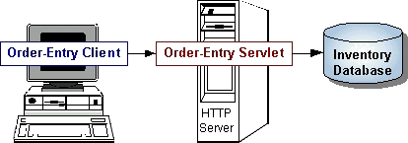

Slide 3
Versus CGI
Easier to Write
Faster to Run
Platform Independence
Handle HTTP Client Requests
HTML Forms

Slide 4
Servlet Package
javax.servlet
Servlet interface defines methods that manage servlet and its communication with clients
Client Interaction: When it accepts call, receives two objects
  ServletRequest
  ServletResponse

Slide 5
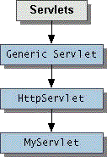
Architecture

Slide 6
ServletRequest Interface
Encapsulates communication from client to server
Parameters passed by client, protocol used by client, names of remote host, and server
ServletInputStream for data transfer from client to server using HTTP POST and PUT
HttpServletRequest access HTTP header info

Slide 7
ServletResponse Interface
Methods for replying to client
Set content length and MIME type of reply
ServletOutputStream and a Writer to send data
HttpServletResponse protocol specific

Slide 8
Http Specifics
MIME: Multipurpose Internet Mail Extension to identify file type
GET/POST/PUT: Ways that browser sends form data to the server
Persistent Sessions
Cookies

Slide 9
public class SimpleServlet extends HttpServlet {
/** * Handle the HTTP GET method by building a simple web page. */
public void doGet (HttpServletRequest request,
HttpServletResponse response)
throws ServletException, IOException {
PrintWriter out;
String title = "Simple Servlet Output";
// set content type and other response header fields first
response.setContentType("text/html");
// then write the data of the response
out = response.getWriter();
out.println("<HTML><HEAD><TITLE>");
out.println(title); out.println("</TITLE></HEAD><BODY>");
out.println("<H1>" + title + "</H1>");
out.println("<P>This is output from SimpleServlet.");
out.println("</BODY></HTML>");
out.close(); }
}

Slide 10
Subclass HttpServlet
Override doGet()
User Request encapsulated in HttpServletRequest object
Response encapsulated in HttpServletResponse object
Use output stream from HttpServletResponse

Slide 11
Interacting with Clients
Requests and Responses
Header Data
Get Requests
Post Requests
Threading
Servlet Descriptions

Slide 12
Handle requests through service method (calls doGet())
HttpServletRequest Objects
  getParameter returns value of named parameter
  getParameterValues if more than one value
  getParameterNames for names of parameters
  getQueryString for HTTP GET returns string of raw data from client. Must parse.
  HTTP POST, PUT, DELETE Requests
    Text: getReader returns BufferedReader
    Binary: getInputStream returns ServletInputStream

Slide 13
HttpServletResponse Object
  getWriter returns a Writer for text
  getOutputStream returns ServletOutputStream for binary
  Set header data before above IO set
  setContentType in header

Slide 14
Online Bookstore
Browse Books for Sale: CatalogServlet
Buy Book by placing it in Cart: CatalogServlet
Get more information of specific book: BookDetailServlet
Manage the Bookstore Database: BookDBServlet
See books in cart: ShowCartServlet
Remove books from cart: ShowCartServlet
Buy books: CashierServlet
Receipt: ReceiptServlet

Slide 15
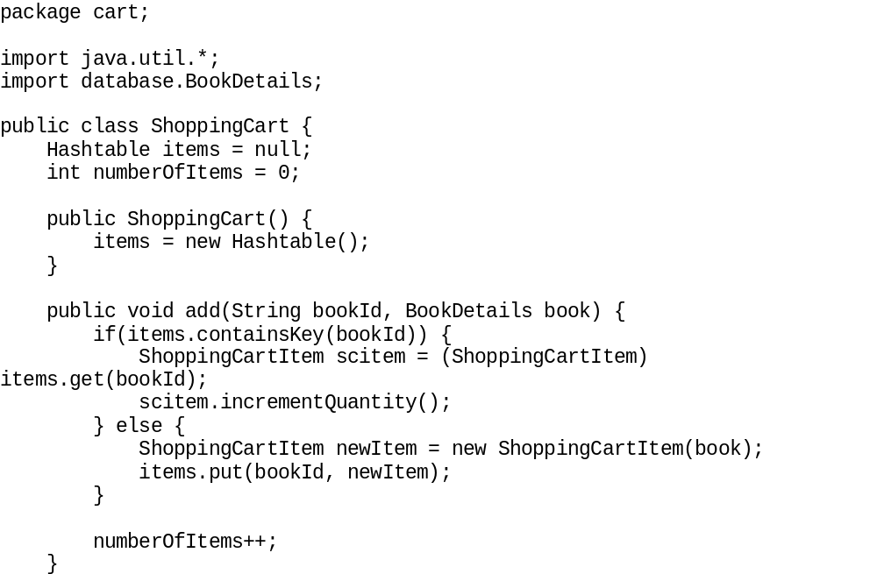

Slide 16
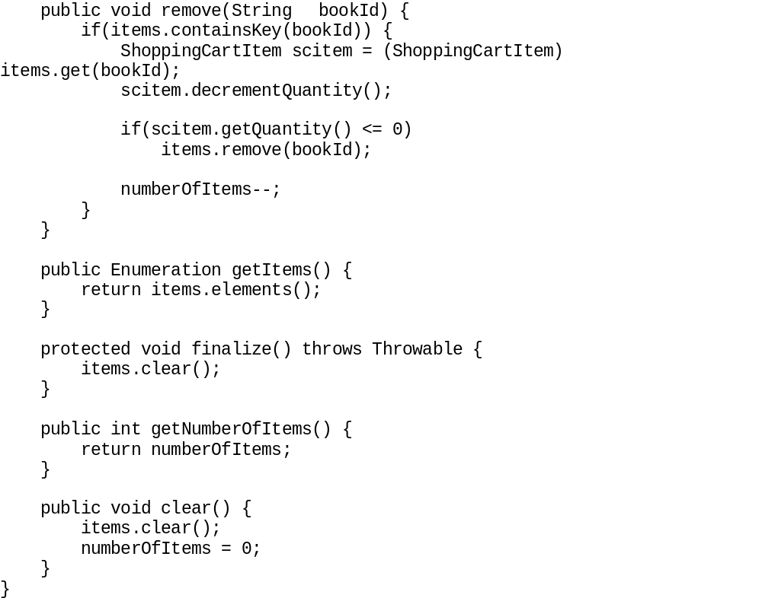

Slide 17
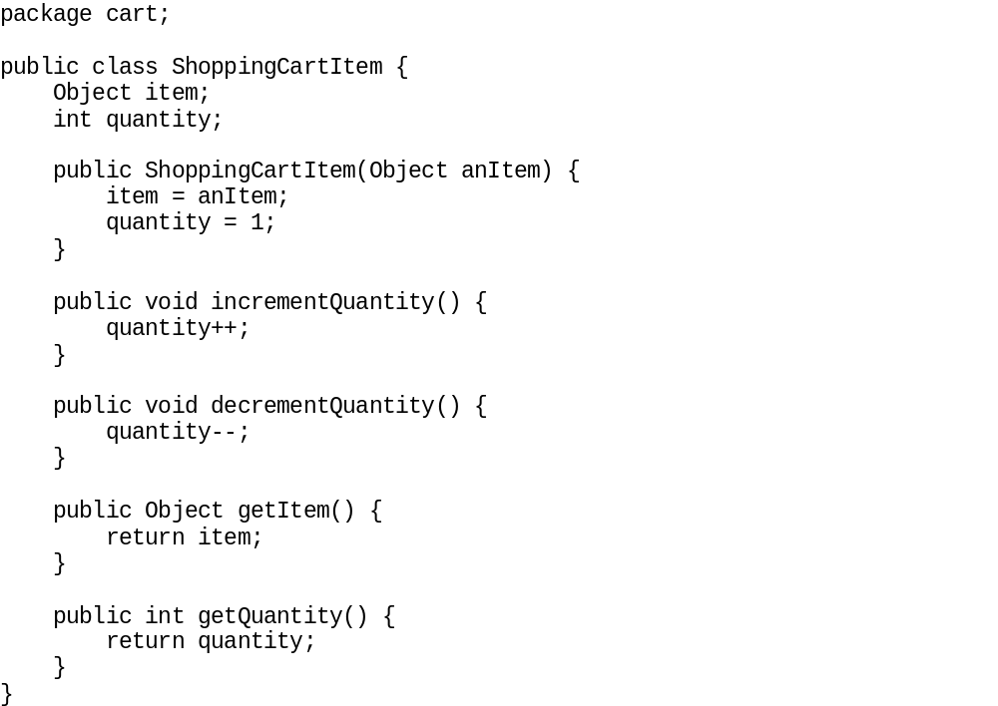

Slide 18
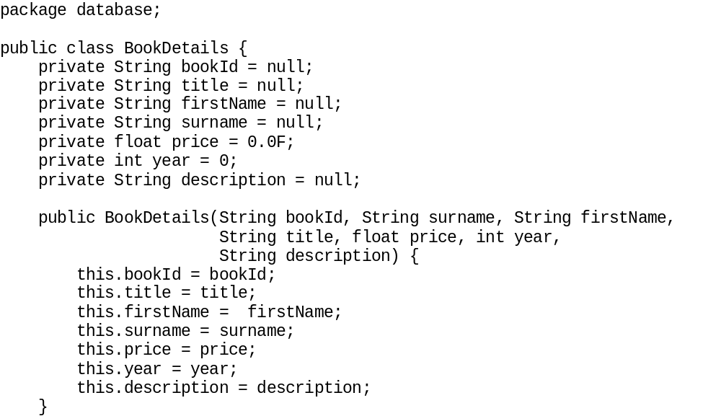

Slide 19
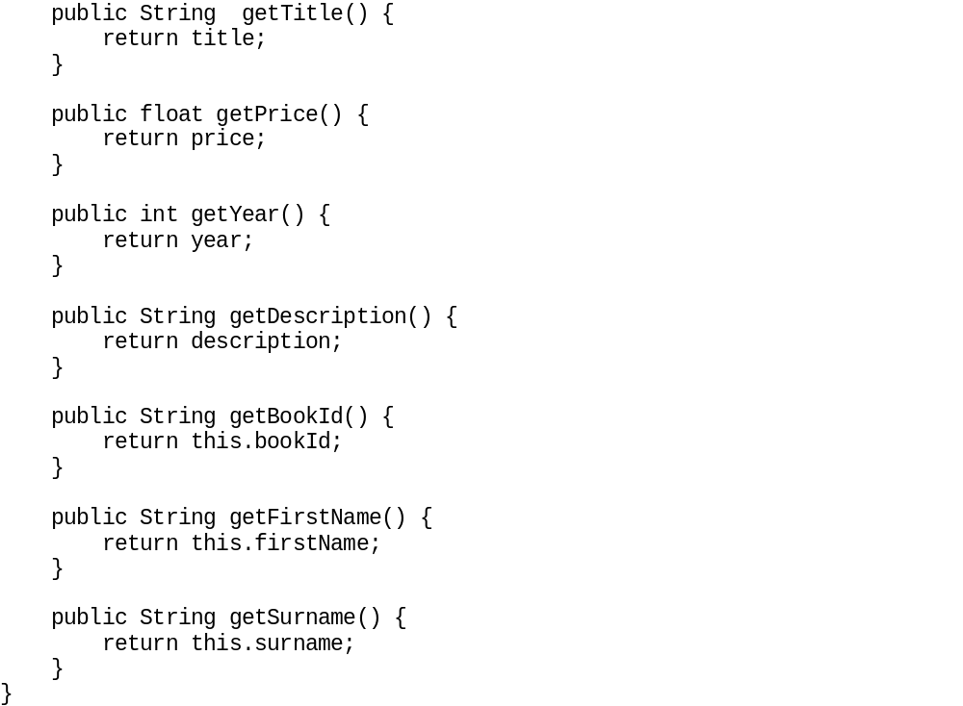

Slide 20
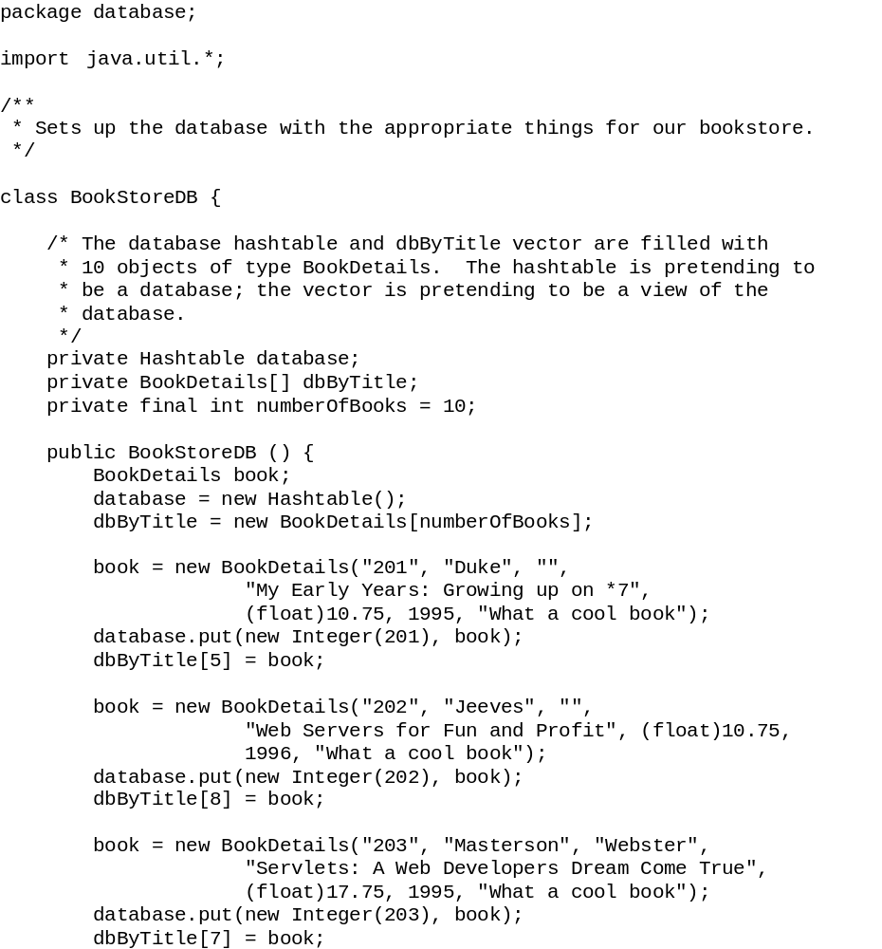

Slide 21
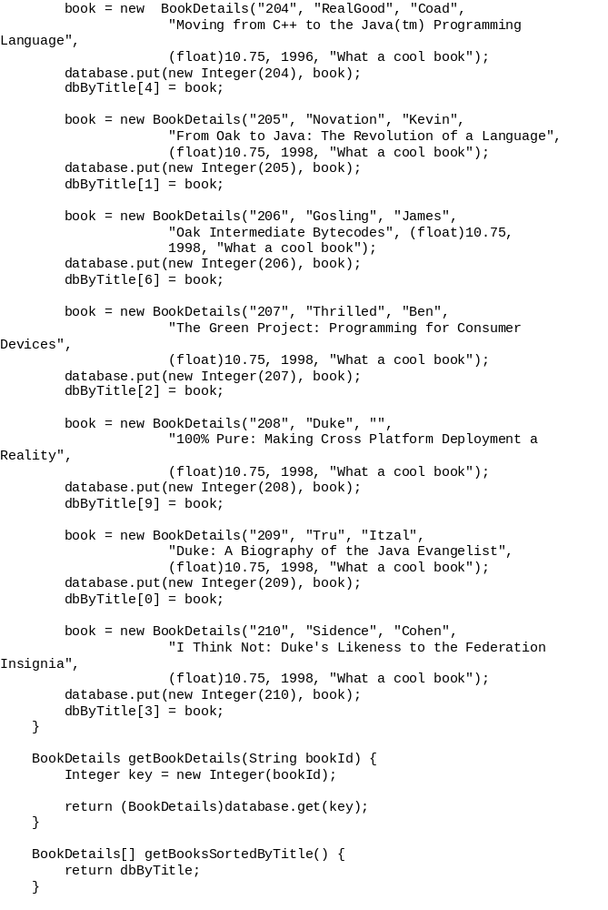

Slide 22
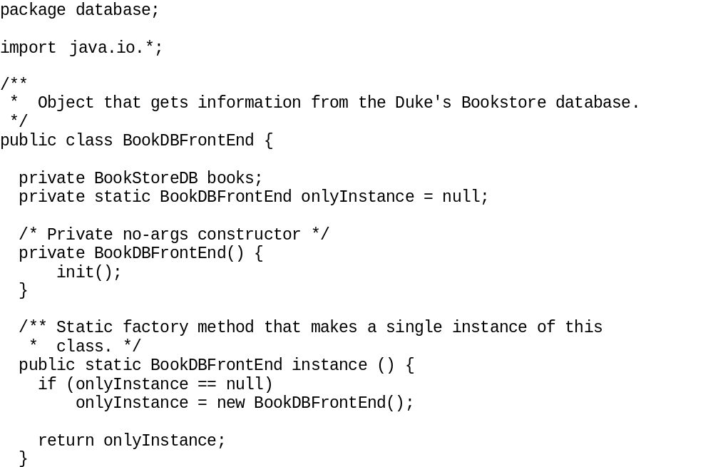

Slide 23
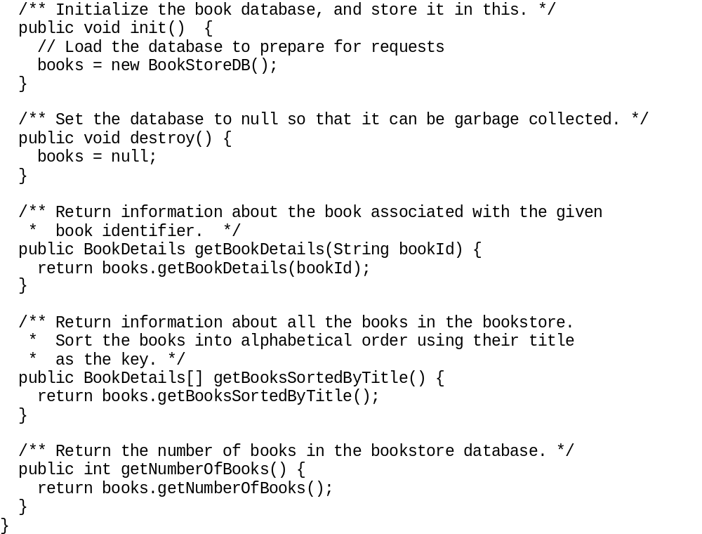

Slide 24
Handling Get Request
Request Object encapsulates client data
getParameter() get value of named parameter
getQueryString() gets raw data from client request. Must parse.
getReader()
GetInputStream()

Slide 25
Sharing Resources
On same server, single applications share resources
Use ServletContext interfaces methods: setAttribute, getAttribute, removeAttribute
Name as with packages
examples.bookstore.database.BookDBFrontEnd

Slide 26
Setting an Attribute
In init()
Check for attribute and set if not found.
public class CatalogServlet extends HttpServlet {
public void init() throws ServletException {
BookDBFrontEnd bookDBFrontEnd = ...
if (bookDBFrontEnd == null) {
getServletContext().setAttribute(
"examples.bookstore.database.BookDBFrontEnd",
BookDBFrontEnd.instance());
}
}
...
}

Slide 27
Getting an Attribute
public class CatalogServlet extends HttpServlet {
public void init() throws ServletException {
BookDBFrontEnd bookDBFrontEnd =
(BookDBFrontEnd)getServletContext().getAttribute(
"examples.bookstore.database.BookDBFrontEnd");
if (bookDBFrontEnd == null) {
getServletContext().setAttribute(
"examples.bookstore.database.BookDBFrontEnd",
BookDBFrontEnd.instance());
}
}
...
}

Slide 28
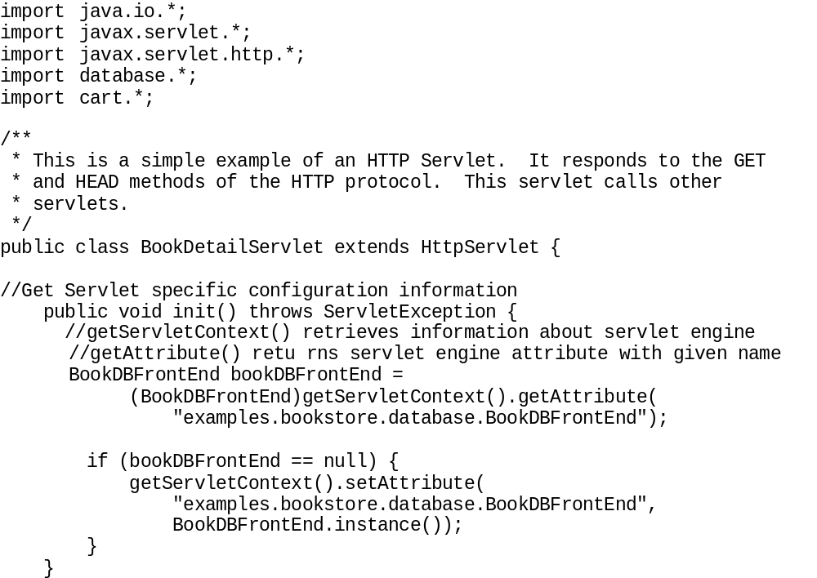

Slide 29
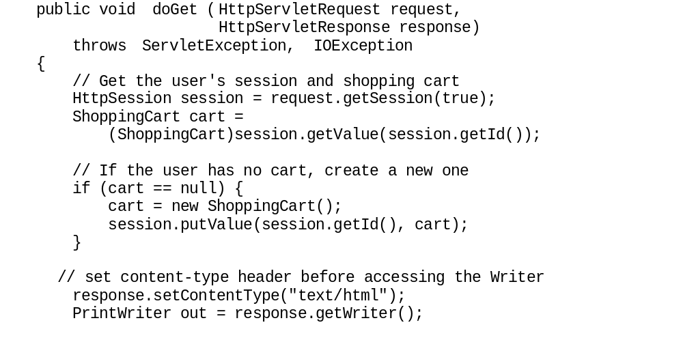

Slide 30
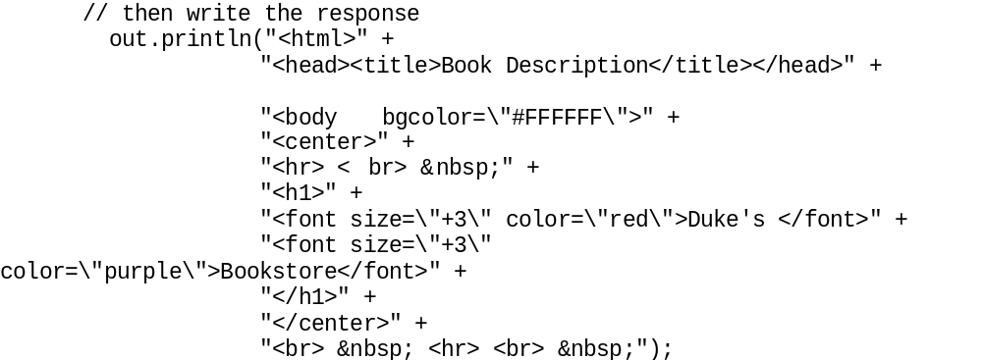

Slide 31
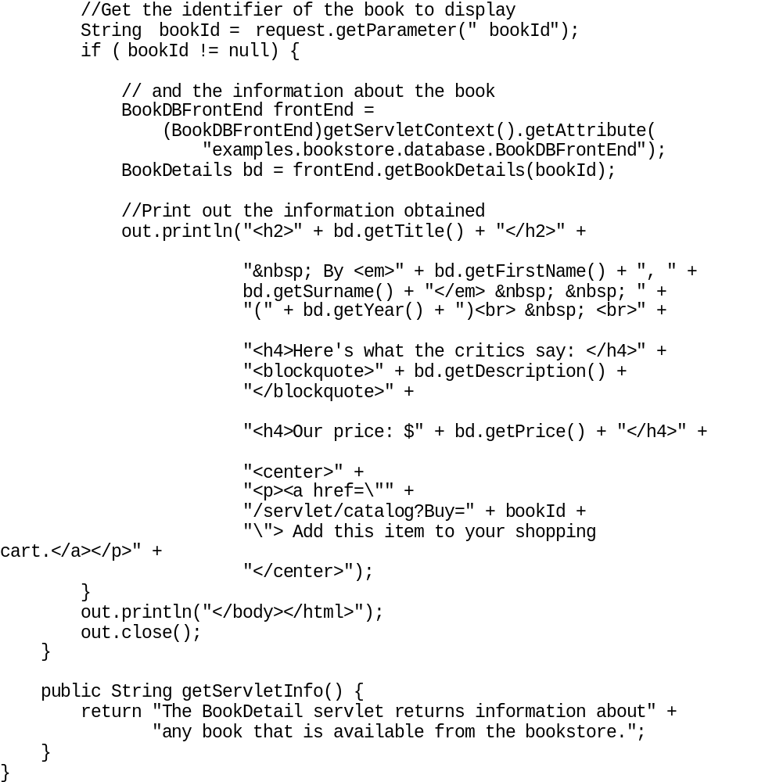

Slide 32
Handling Post Requests

Slide 33
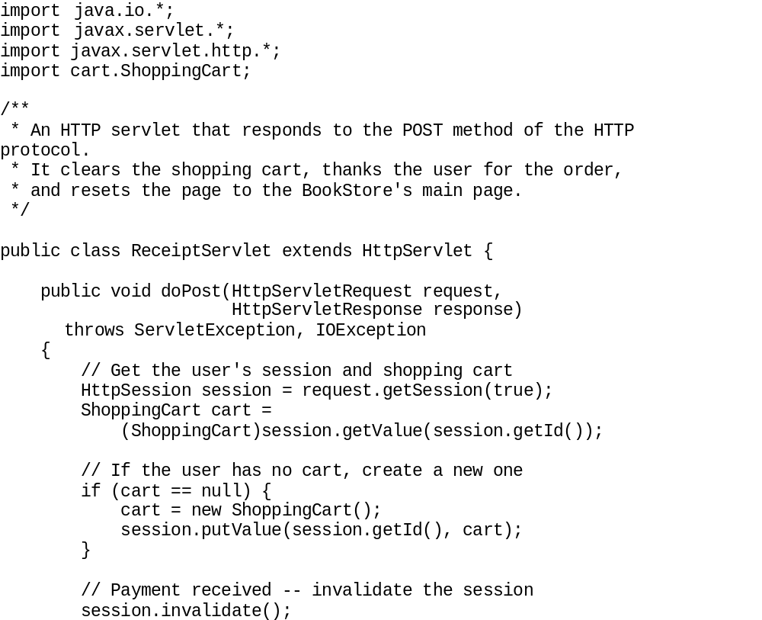

Slide 34
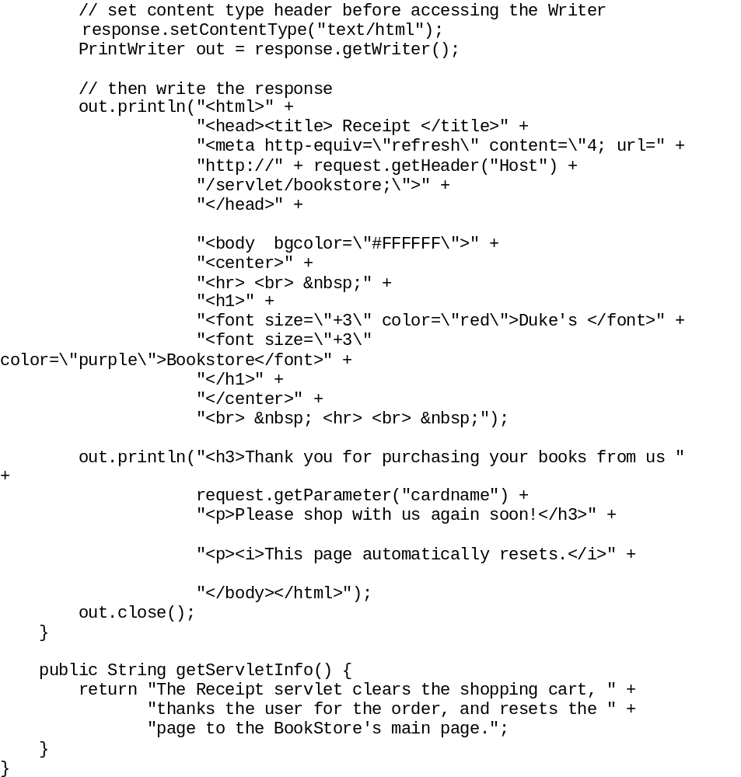

Slide 35
Servlet Descriptions
To allow server to display information about servlet
getServletInfo
public class BookStoreServlet extends HttpServlet {
...
public String getServletInfo() {
return "The BookStore servlet returns the " +
"main web page for Duke's Bookstore.";
} }

